Slide 1
LIMITS (continued.)

Slide 2
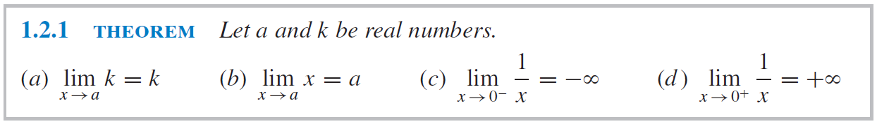
SOME BASIC LIMITS

Slide 3
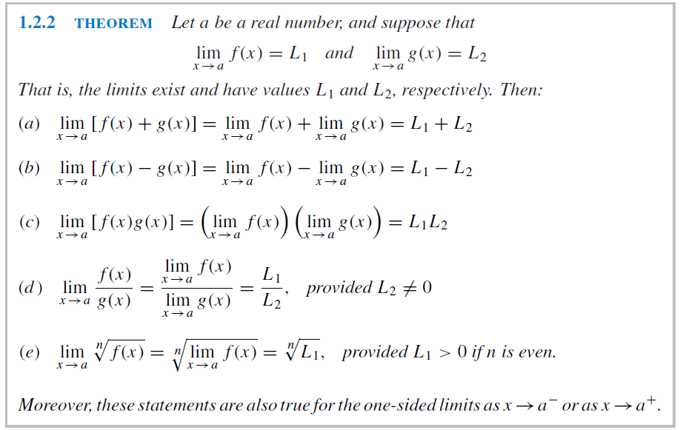
SOME BASIC LIMITS

Slide 4
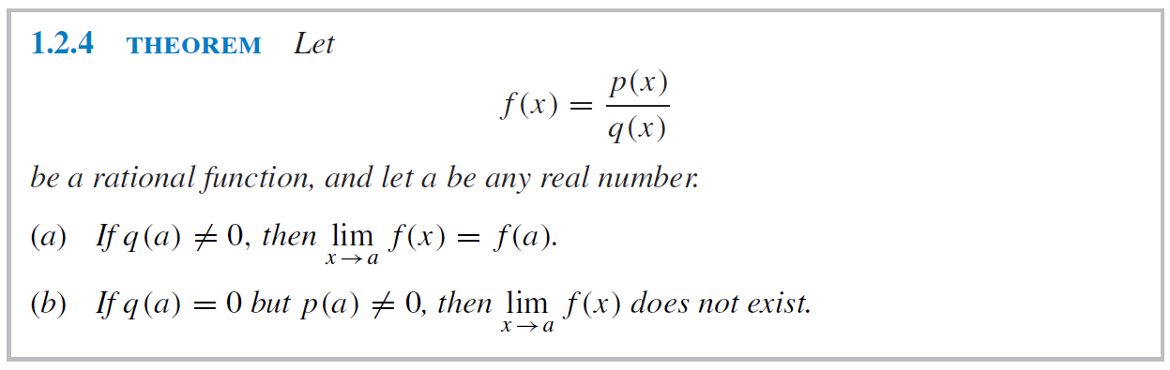
SOME BASIC LIMITS

Slide 5
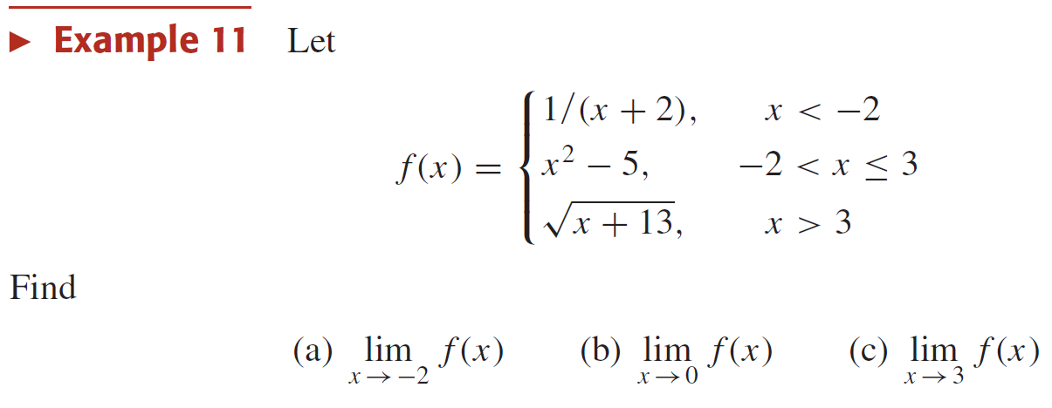
LIMITS OF PIECEWISE-DEFINED FUNCTIONS

Slide 6
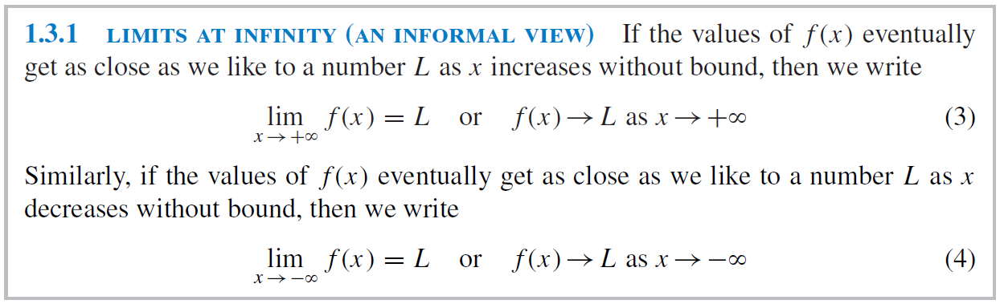
LIMITS AT INFINITY

Slide 7
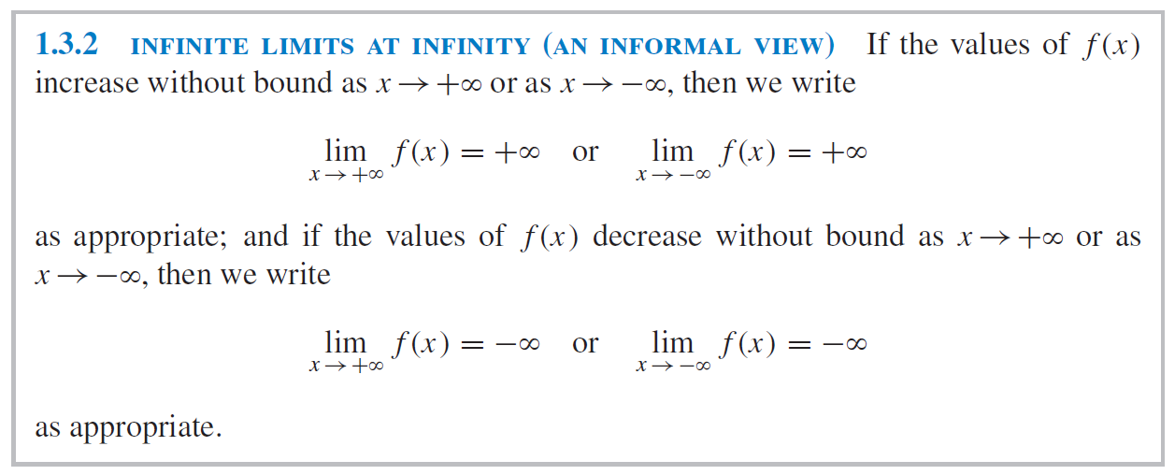
LIMITS AT INFINITY

